Slide 1


COMS W4115 Project
Calcul²
Junde Huang (jh3419)
Kewei Ge (kg2481)
Jinxi Zhao (jz2540)
Wenting Yin (wy2214)
Zhan Shu (zs2242)
Final Report
http://t.cn/8k0USe2

Slide 2
Overview
1. Simple calculus calculating language for mathemetical function evaluation, derivation and integration.
2. Build-in types: Floats, Single and Multivariate Math Functions.
3. Dynamic and Strong typed.
http://www.ppthi-hoo.com

Slide 3
Motivation
1
Calculating Calculus
With powerful bulid-in math functions
Why Calcul²?
2
Math-like Coding
Easy to understand at first glance
3
Studying Tool
For teachers and students on calculus
http://www.ppthi-hoo.com

Slide 4
Language Tutorial
Function Declaration: f($x)=x^2;
Function Evaluation: f(3);
Function Derivation: f'(x);
Function Integral: f@x(1,3);
Multivariate Functions:
Declaration: g($x,$y)=x+y*2;
Function Evaluation: g(1,2);
Function Derivation: g'(x);
Mathmatical Functions
http://www.ppthi-hoo.com

Slide 5
Language Tutorial
input.cul
output
main()
{
f($x) = 2 * x;
g($x) = sin(x);
h($x) = f + g;
:h;
:h’(x);
}
2 * x + sin(x)
2 + cos(x)
http://www.ppthi-hoo.com

Slide 6
input.cul
Implementation
Scanner?
Codegen
Token
Parser?
output.cpp
calcul2.h
Ast
g++ compiler
Semantic?
Failed
a.exe
http://www.ppthi-hoo.com

Slide 7
Implementation
Development Tools/Environment
Eclipse
Ocamalyacc/Ocamllex
Vim
g++ Compiler
GitHub
Makefile
Linux/Mac/Windows
http://www.ppthi-hoo.com

Slide 8
output.cpp
Implementation
int main()
{
double printer;
vector<string> f_var;
f_var.push_back("x");
vector<double> f_begin, f_end, f_now;
FTree f(f_var);
f.AddNode(new FNode(T_OP,0,PLUS));
f.AddNode(new FNode(T_OP,0,POWER));
f.AddNode(new FNode(T_VAR,0,0));
f.AddNode(new FNode(T_VAL,3.));
f.AddNode(new FNode(T_OP,0,TIMES));
f.AddNode(new FNode(T_VAL,3.));
f.AddNode(new FNode(T_VAR,0,0));
f_now.clear();
f.Derive("x") -> Print();
cout << "\n";
return 0;
}
input.cul
main()
{
f($x) = x ^ 3 + 3 * x;
:f'(x);
}
output
3 * x ^ 2 + 3
http://www.ppthi-hoo.com

Slide 9
Lesson Learnt
Project Lives on Teamwork
Plan Limited by Time
Problems Lessen by Testing
Practical Lively Things
http://www.ppthi-hoo.com

Slide 10
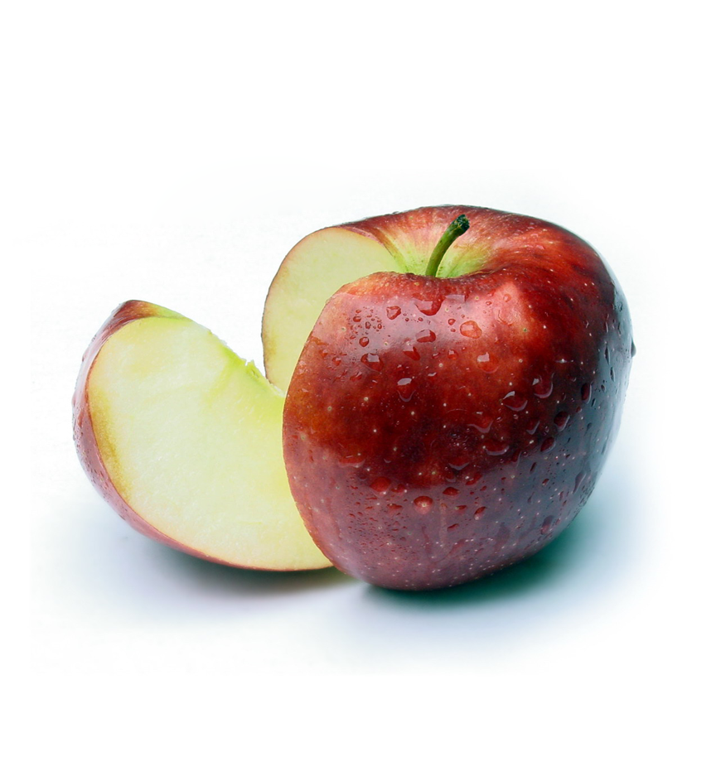
THANKS!
http://t.cn/8k0USe2

